Slide 1
Digital Forensics Windows Forensic Analysis
Dr. Tran The Son
Vietnam – Korea University

Slide 2
Timeline analysis tools
Recycle Bin Analysis
Data carving
Windows registry analysis
USB device forensics
Printer registry information
File format identification
Windows thumbnail forensics
Windows 10 forensics
Notification area database
Cortana forensics

Slide 3
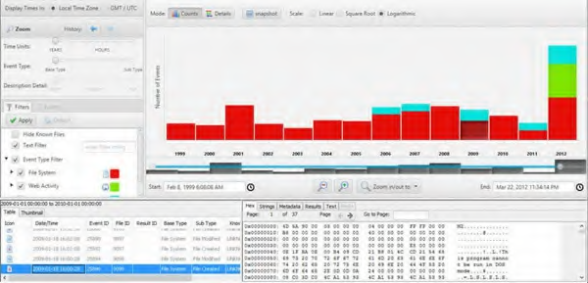
Timeline analysis
Most digital forensics investigations include timeline analysis because it provides a comprehensive perspective of the sequence of events that occurred on the system
Autopsy
Tools menu
>> Timeline
Mode for bar charts
Detail mode
List mode

Slide 4
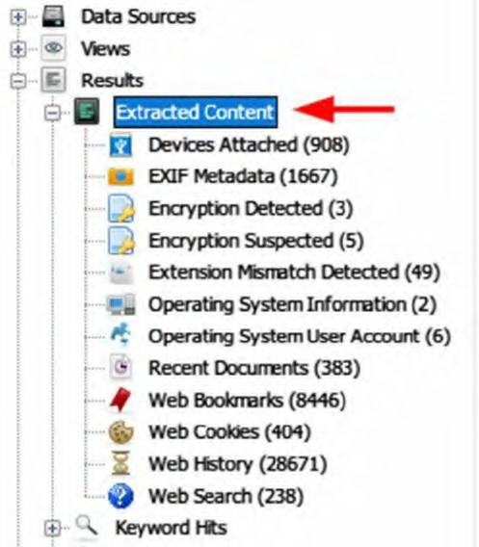
Timeline analysis
Report

Slide 5
File recovery
Undeleting Files

Slide 6
Associated user account action
The SID is a one-of-a-kind number that differentiates each account on a Windows PC
The command
“wmic useraccount get name, sid”
is used to find out the name of
the user account that owns a given SID subdirectory.

Slide 7
Recycle bin forensics
When a user deletes a file, Windows will automatically send it to the recycle bin.
C:\Recycler
C:\$Recycle.Bin
The default size in recent Windows versions, such as Vista and beyond, is 10% of the first 40 GB of storage space and 5% of the remaining storage space over 40 GB.
beginning with “$R”: recycled file’s contents ,
beginning with “$I”: the deleted file’s metadata

Slide 8
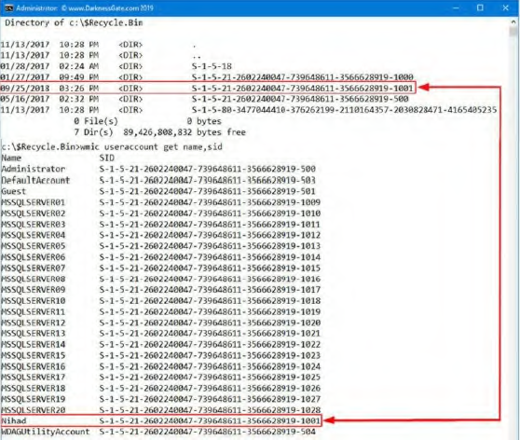
Recycle bin forensics
$Recycle.Bin is divided into four subfolders, each corresponding to the SID of the person who removed the file.
When the file is deleted, it is sent to the recycle bin for the first time, and then a subfolder is also created.
The command
“wmic useraccount get name, sid”
is used to find out the name of
the user account that owns a given SID subdirectory.

Slide 9
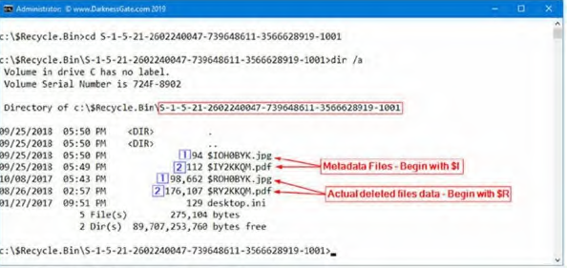

Recycle bin forensics

Slide 10
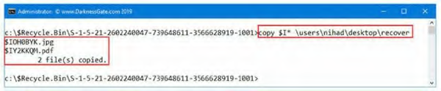
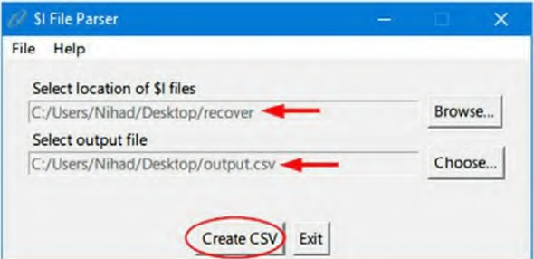

$I Parse Tool https://df-stream.com/tools/
copy $I* \users\ desktop\recover

Slide 11
Exercise
Use $I Parse Tool to determine activity of a given user

Slide 12
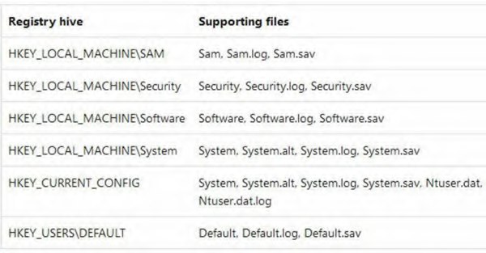
Windows registry analysis
image Registry hives are stored in the Windows | System32 | Config folder

Slide 13
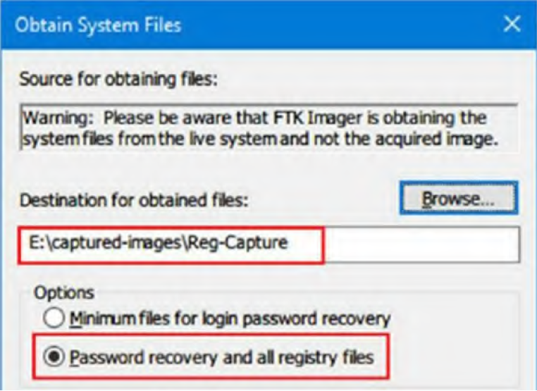
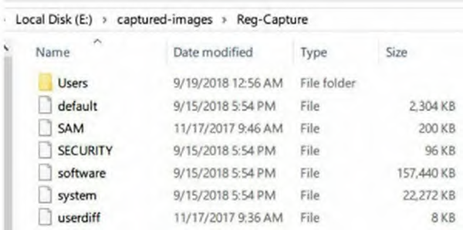
Acquiring windows registry
AccessData FTK Imager (in USB)
click File > "Obtain Protected Files"

Slide 14
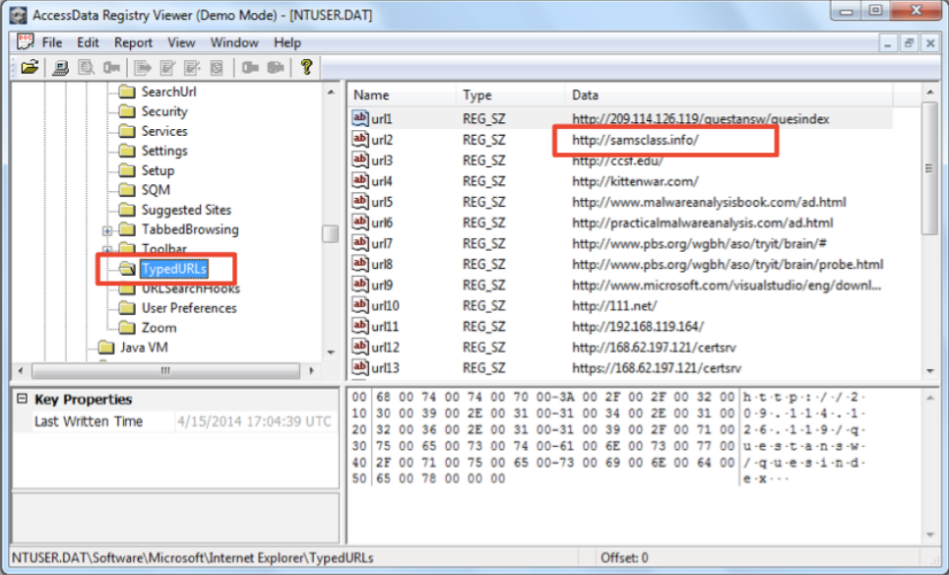
Registry Viewer
NTUSER.DAT\Software\Microsoft\Internet Explorer\TypedURLs
NTUSER.DAT\Software\Microsoft\Windows\CurrentVersion\Explorer\UserAssist
NTUSER.DAT\Software\Microsoft\Windows\CurrentVersion\Explorer\RecentDocs
SYSTEM\ControlSet001\Enum\USBSTOR
SYSTEM\ControlSet001\Control\Windows ➔ last shutdown time

Slide 15
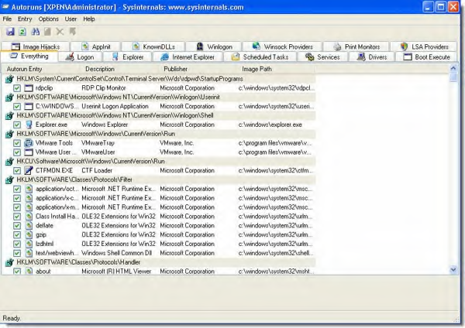
Registry examination
Autorun (SysInternals)

Slide 16
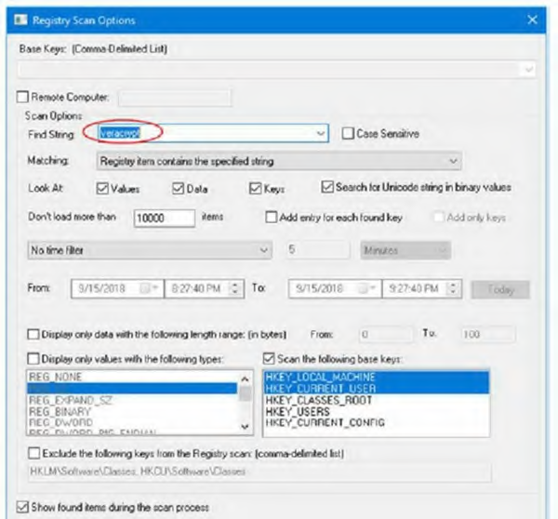
Windows registry program keys
RegScanner
We can use automated tools to look for a program installed inside the Windows registry or search for lost information like pieces of installed programs, apps that have been left behind, or any other data items that can be concealed in the Windows registry

Slide 17
Thực hành
Tạo 1 Registry Image bằng FTK imager
Sử dụng “Registry Viewer” của AccessData FTK khảo sát
Các URL của user sử dụng để truy cập website
Các ứng dụng/chương trình đã sử dụng của ng.dùng
Các loại USB đã từng cắm vào hệ thống
Thời gian tắt máy cuối cùng của PC
Gửi kq về các loại USB đã cắm vào hệ thống và giờ tắt máy cuối cùng về email: ttson@vku.udn.vn

Slide 18
Data carving
Data carving is used in digital forensic investigations as a part of sophisticated data recovery when extracting specific files using the file footer and header information.
Tools
Hex editor
Foremost
Scalpel
Jpegcarver
Forensics wiki.

Slide 19
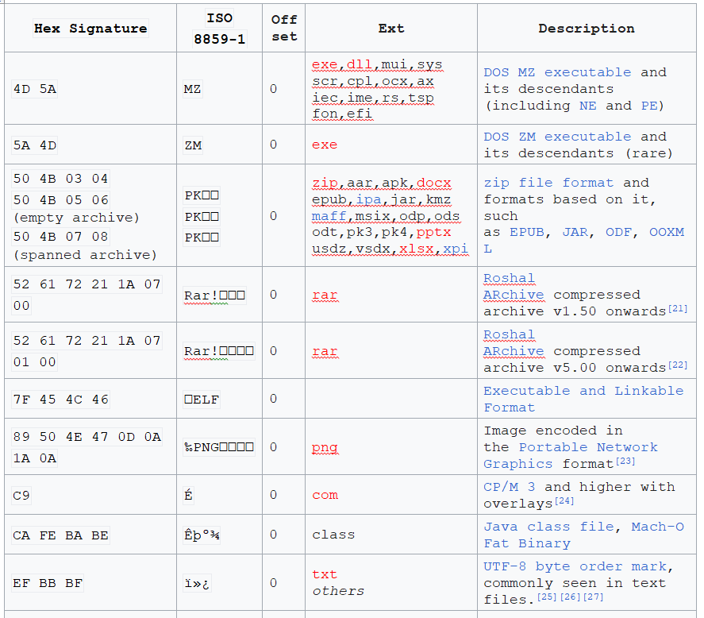
Data carving
File
Signatures
Most of trailer (footer) of a file: EOF. (45 4F 46 OA)

Slide 20
Exercise
Xác định header/trailer của một số file phổ biến hiện nay
Doc, docx
Ppt, pptx,
Xls, xlsx
Bmp
Gif
Jpeg
Zip
Pdf
….

Slide 21
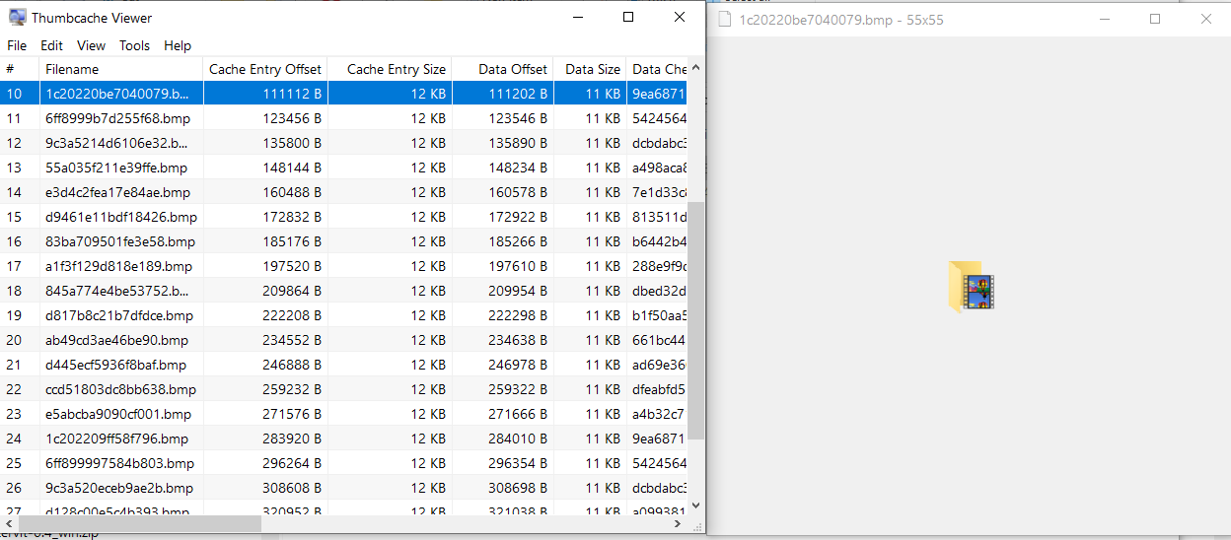
Windows thumbnail (cache) forensics
Windows saves thumbnails of graphical files (JPEG, BMP, GIF, PNG, and TIFF), some document types (DOCX, PPTX, and PDF), and video files in the thumbs.db or thumbcache_*.db
Users\<USERNAME>\AppData\Local\Microsoft\Windows\Explorer.

Slide 22
Notification area database
Any program that can generate a systray notification will save it in a centralized database (Windows 8, Win 10+).
Users\<USERNAME>\AppData\Local\Microsoft\Windows\Notifications

